Slide 1

Linux
Team Pi

Slide 2

Find the Path
sudo find / -name “filename”

Slide 3
Use the grep command to list and save
Grep is a tool used for searching text.
It command consist of grep then options followed by the search expression and then the file(s) location(s).

Slide 4

GREP
Print to text file words ending with ‘ing’
To get search results ending with ‘ing’ you would use:
grep ing grep_wordlist
the we could add ‘> output.txt’ to print it to the file. So we would end up with:
grep *ing grep_wordlist > output.txt

Slide 5
GREP
Count words ending with ‘ing’
grep ing grep_wordlist| wc -l
Grep will sort all the lines with ing word then pipe it to wc which will count the number of lines.

Slide 6

GREP
Count words beginning with ‘be’
This will be similar to the ing word only the wild card will go after search phrase.
grep ing grep_wordlist

Slide 7

GREP
Find the exact word “test”
It is the same as before only we use the -w option to not include substring results.
grep -w test grep_wordlist

Slide 8

GREP
Find all word that start with ‘m’ and end with ‘t’
Adding a .* will allow for all combinations but requires something between. The -w makes sure that the m and t are the ending letters.
grep -w m.*t grep_wordlist

Slide 9

GREP
Find all word that start with ‘m’ and end with ‘t’
Adding a .* will allow for all combinations but requires something between. The -w makes sure that the m and t are the ending letters.
grep -w m.*t grep_wordlist

Slide 10
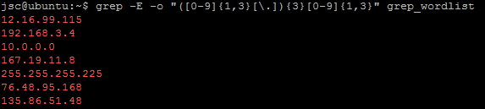
GREP
Find out the IP address
The expression will look for anything between 0.0.0.0 to 999.999.999.999 inclusive.
grep -E -o “([0-9]{1,3}[\.]){3}[0-9]{1,3}" grep_wordlist

Slide 11
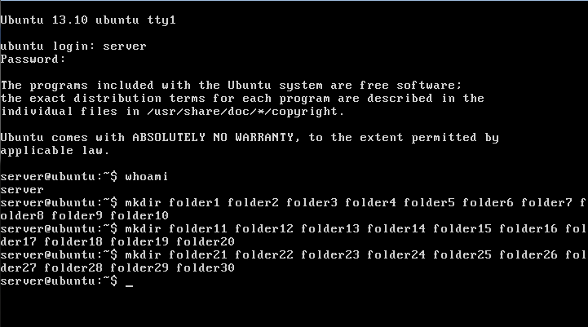
Make 30 Folders in your home directory
mkdir <folder_name>
This command will make a new directory. Multiple can be created in one line by separating names with spaces.

Slide 12
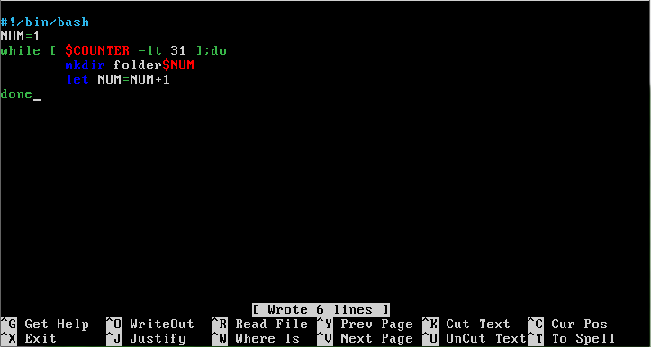
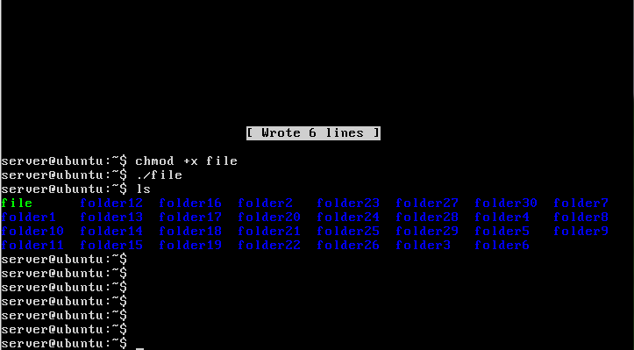
Make 30 Folders in your home directory
SCRIPT
But this is very tedious and can easily be performed with a bash script. There is the script and the command to run it.

Slide 13
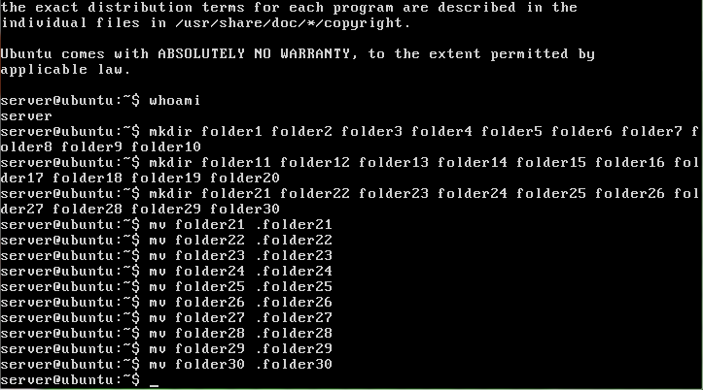
Make folders 21-30 hidden
mv <folder_name> .<folder_name>
To hide a file or directory you add a dot to the beginning of the name. Since you can’t rename a file you just move it to the same dir while adding a dot to the name.

Slide 14
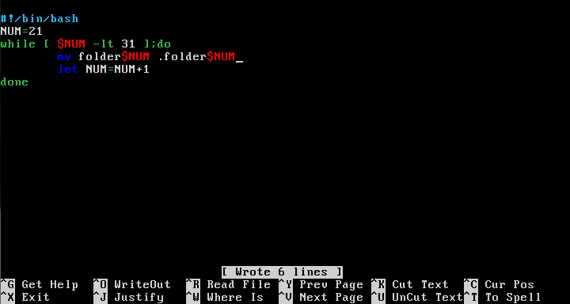
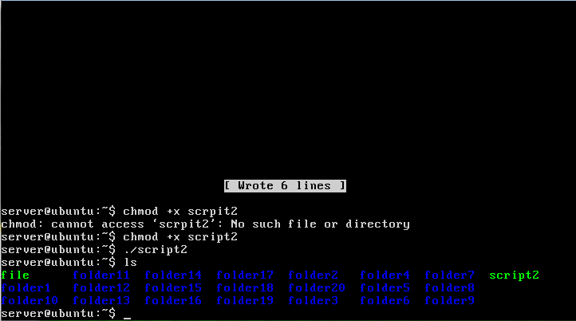
Make folders 21-30 hidden
SCRIPT
Same situation as before. Here is the script and commands.

Slide 15
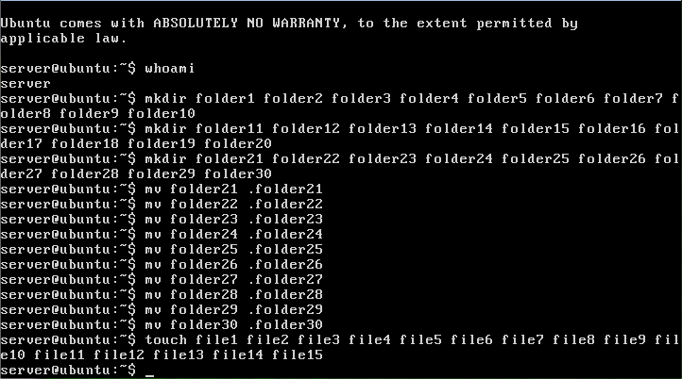
Create 15 .txt files
touch <file_name>
The touch command will create a blank document with the specified name. Multiple can be created in one line by separating names with spaces.

Slide 16
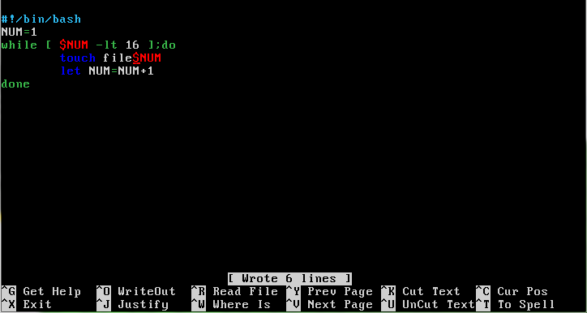
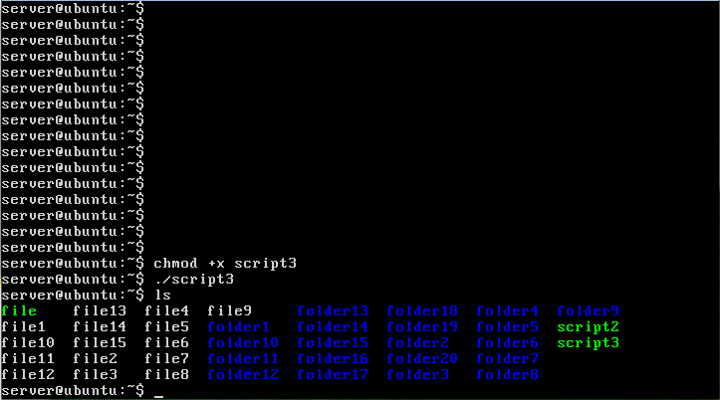
Create 15 .txt files
SCRIPT
Here is the script version.

Slide 17
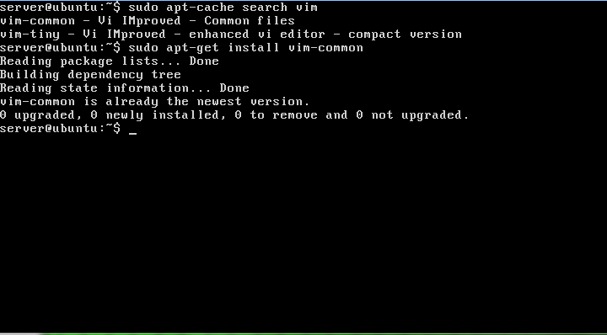
Install vim
sudo apt-cache search vim
sudo apt-get install vim-common
The standard vim package was not available, so we used the apt-cache command to search for the available versions. We chose vim-common, but it was already installed.

Slide 18
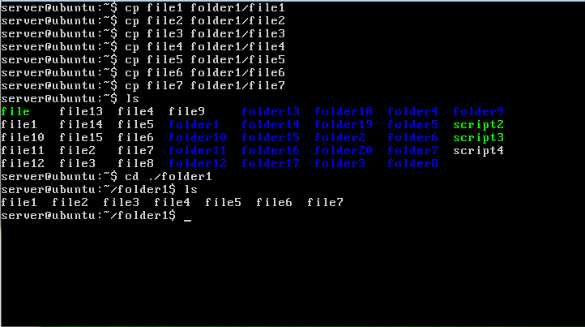
Copy files 1-7 to folder 1
cp <file_dir/name> <new_file_dir/name>
This command makes a copy of the file or directory in the specified location.

Slide 19
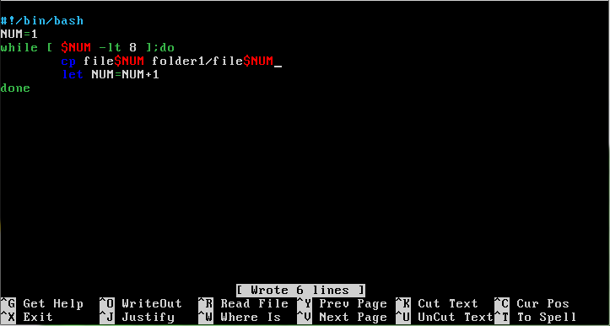
Copy files 1-7 to folder 1
SCRIPT
Script to complete the same task.

Slide 20
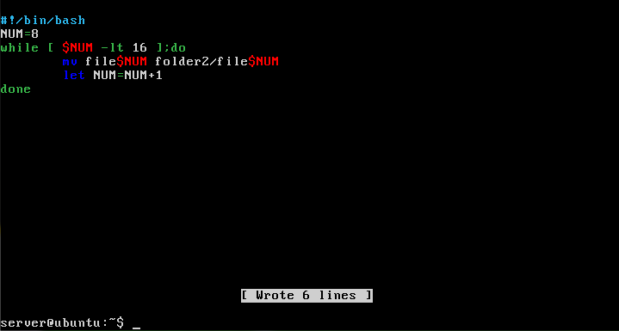
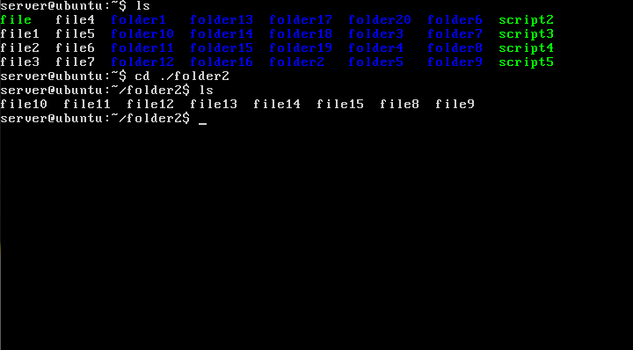
Move the rest of the files to folder 2
mv <file_dir/name> <new_file_dir/name>
For this we will only use the script. The command is the same when used in the script and will still be listed in the corner of slide.

Slide 21
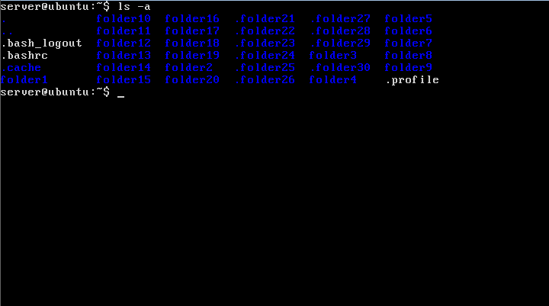
List out all the hidden folders in your home directory
ls -a
The ls command normally lists all files and subdirectories in the directory but will not list hidden files and directories. You must add the tac a to do so.

Slide 22
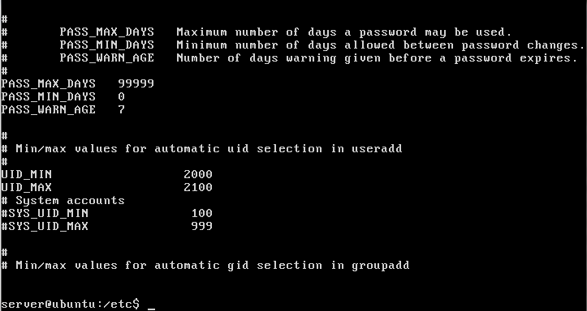
Configure so that the user uids start from 2000 and only allow 100 users to be created
sudo nano login.defs
This command will open the configuration file. Find UID_MIN and change it to 2000. Then change the max to 2100

Slide 23
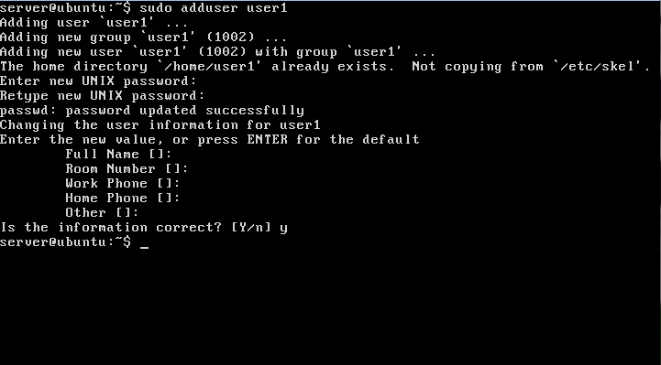
Create 30 users
sudo adduser <username>
This will add a standard user. It will prompt you for other info and will automatically create a home directory.

Slide 24
Assign Passwords for each user
When you create a new user it prompts you for a password and is set there.

Slide 25
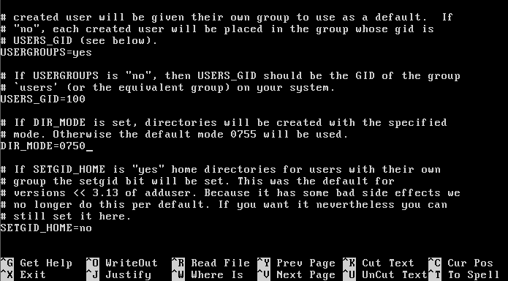
Login users 1,2,4,20,28 then designate the home directories to which they can log on
You can set directory mode for all new users by going to adduser.conf and changing dir_mode to 0750. For existing users go into the etc folder and change umask mode to 077.

Slide 26
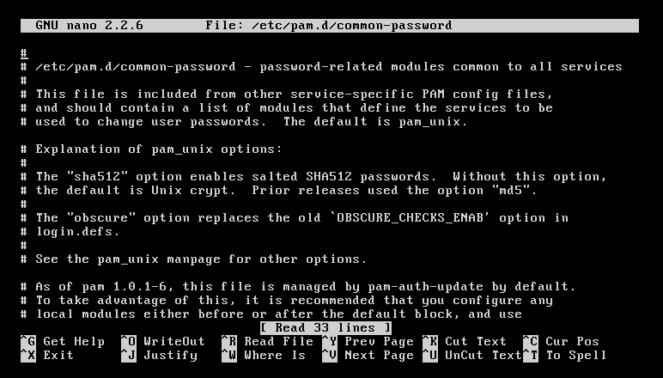
Editing Pam File
Password complexity is handled by a file called Pam. Access the file with the path,
/etc/pam.d/common-password
and it will look like this.

Slide 27
Passwords must be allowed to have lower and uppercase, symbols, and numbers
I couldn’t find an option to change this setting. However, I could set passwords with all of these characters in them by default.

Slide 28
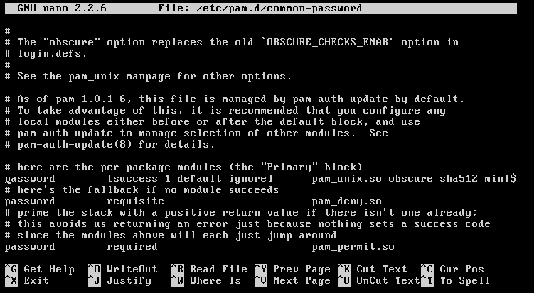
Passwords must be hashed with 512
My system was hashing the passwords in this form by default. The hashing method is determined by this part of the text in the pam file.

Slide 29
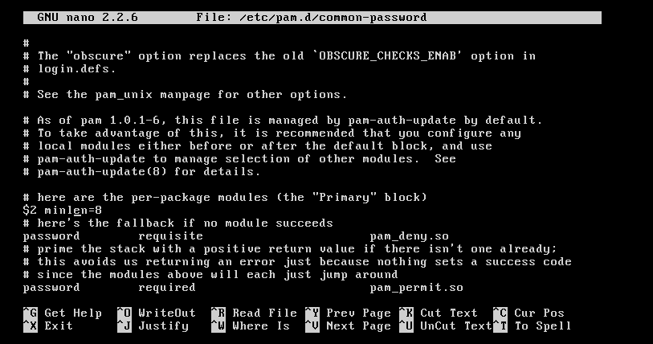
Minimum length must be 8
Setting a password’s minimum length is done by adding “minlen=n” to the end of the line shown here.
Note that only the end of the line is shown, as it is too long to be displayed on one line.

Slide 30
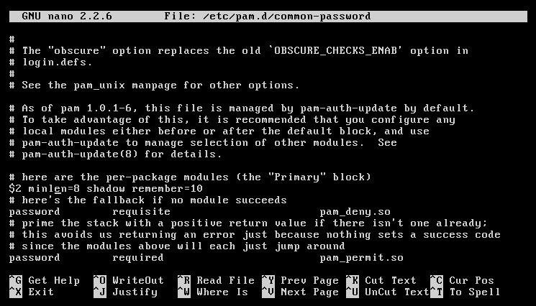
Set password history to 10
Password history stops you from using the same password multiple times, use the line
“Shadow Remember =n”
In the place shown on the right.

Slide 31

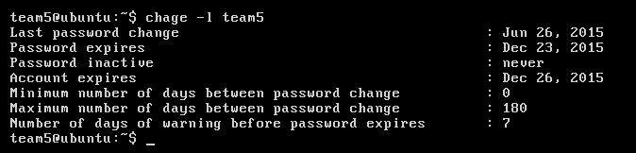
Add expiration date for the account to 6 months from the date you created the account
The command on the right will set the expiration date for an account. You can also use a normal number and it will use that number as the number of days after the date January 1st 1970.

Slide 32

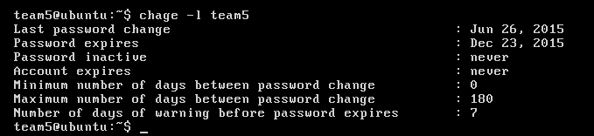
Set the max days after which the user must change passwords
The command on the right will force a user to change their password every 180 days, or approximately 6 months.

Slide 33

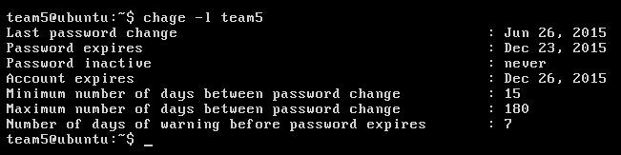
Set minimum number of days allowed between password changes to 15
The command to the right can be used to set a minimum number of days that must pass before a user can change their password.

Slide 34

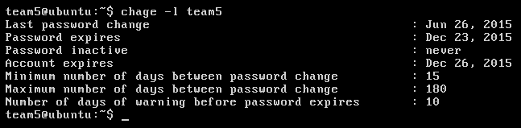
Give a 10 day warning before the password expires
The command on the right can be used to give a warning before your password needs to be changed. Thus you have time to come up with a secure one.

Slide 35

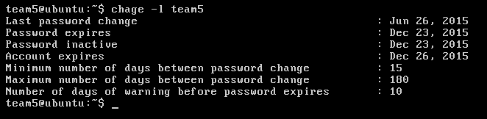
Make it inactive if the account is expired
This command will make a password inactive once it’s account expires.

Slide 36

Set the maximum number of attempts to login to 5
First add the line to the right to the files
/etc/pam.d/common-auth
at the top.
Then enter the command shown below .

Slide 37

Change login lockout time to 5 minutes
This command sets how long a failed log in will lock a user out in seconds.

Slide 38
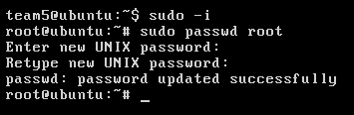
Make root’s password the same as your password
This is the command to edit the Root account’s Password. Be aware that logging in as the Root is dangerous and rarely necessary, as using sudo will give you most all permissions you’ll need the root for.

Slide 39

Configure so that the users have to create a new password when they login the first time
After creating a new account use this command to expire their password. This will force them to change it on login.

Slide 40

Make sure you record failed logins
lastb
-a displays records for all users
-r resets the records
-u displays the records for a specific user

Slide 41
Write down the ENV_PATH and ENV_SUPATH
nano /etc/login.defs
Open up the login.defs file and find the two paths

Slide 42

Set encryption to SHA 512 and encrypt for 10,000 rounds
nano /etc/login.defs
Encryptions is set to SHA 512 by default
It is found in the login.defs file
To encrypt for 10,000 rounds just find the SHA_CRYPT_MIN and MAX_ROUNDS and set them each to 10,000 in the same file

Slide 43
Configure user login times
nano /etc/pam.d/login
nano /ctc/security/time.conf
Remove the comment
Add users and login times to end of file

Slide 44

Find out when user 1 last logged on
last username

Slide 45
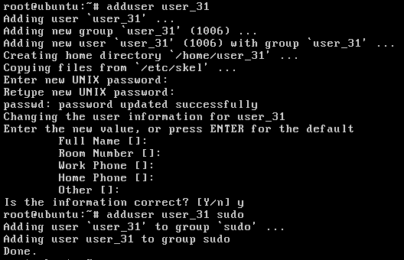
Create 5 more users with admin rights
adduser <username>
adduser <username> sudo
Create user
Add user to sudo group

Slide 46

Configure so that user 30 has auto-login set
mkdir /etc/lightdm/lightdm.conf.d
nano /etc/lightdm/lightdm.conf.d/50-myconfig.conf
Make a directory
Create a file in the directory and edit it to include this

Slide 47
Create 4 groups with 2 users in each group
groupadd GroupName
usermod -a -G GroupName Username
First create a group
Then add an existing user to the group

Slide 48
Write down the permission of the shadow file
ls -la /path/to/directory
The folder has read and write permission for the owner denoted by the -rw, read permission for the group (-r) and no permissions for other and is owned by root

Slide 49
Give yourself ownership of folder_1 through folder_10
chown -R username directory
Use chown command
-R gives ownership of all subfolders and files as well

Slide 50
Make the group CEO the owner of folder_11 to folder_15
chown -R :group directory
This command simply changes the ownership of folders or files
You can use username:groupname to change the user and group permission or just username: for the user and :groupname for just the group

Slide 51

List all the groups you made
cat /etc/group
This command lists all the groups including system ones and the users in each group

Slide 52

Create a file named test, test_1, and test_2 and write down the default permissions
>filename
ls -l /path/to/file
This creates an empty file
Then we can list the default permissions which are read/write for the owner, read for the group, and read for others

Slide 53
Change the permission of test so that only the owner has read write permissions
chmod -R u+rw /path/to/file
chmod changes permissions
-R means all subfolders and files
u = user that is owner
rw = read write

Slide 54

Change the permission of test_1 so that the owner has read, write, and execute permissions, the group has read and execute permissions and other users have no permissions
chmod -R ugo+rwx /path/to/file
Give group read and execute
Give owner read, write, execute
Give others none

Slide 55
Change the permission of test_2 so that the owner, group, and user have read, write, and execute rights
chmod -R ugo+rwx /path/to/file

Slide 56
Create folders CEO, developer, and marketing in the home directory and configure so that only the CEO group can access the CEO folder, the developer group can access the developer folder, and the marketing group can access the marketing folder
mkdir /path/to/directory
chown -R :group /path/to/directory
chmod -R g+rwx /path/to/directory
First we create the folders
Then set the owner of the folder
Then change the permissions of the folder

Slide 57
Update and Upgrade Ubuntu
apt-get update
apt-get upgrade
These commands use the internet to search for any new updates to packages and software and then download and installs them

Slide 58
Resources
askubuntu.com
help.ubuntu.com

